Slide 1
"Unlocking User Insights: A Telecommunication Case Study"
By: Surabhi Patil

Slide 2
Brief Overview:
In today's competitive telecommunications market, understanding user behavior and experience is crucial for driving business growth.
This project aims to analyze user data from TellCo, a telecommunications service provider, to identify key insights and opportunities for improvement.

Slide 3
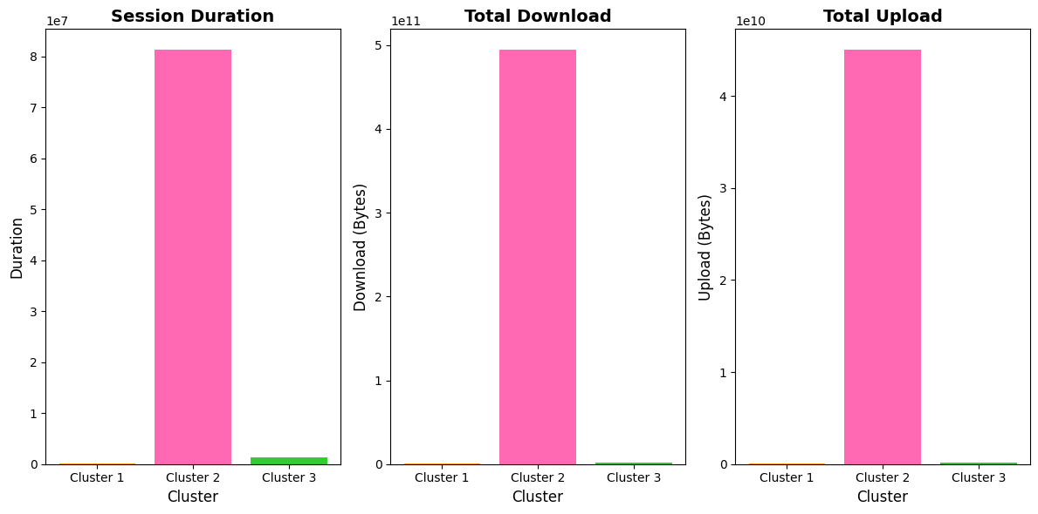
Cluster Analysis: User Engagement Patterns

Slide 4
Cluster 2 dominates: Cluster 2 exhibits significantly higher values for session duration, total downloads, and total uploads compared to the other two clusters.
Cluster 3 shows moderate activity: Cluster 3 displays moderate levels of session duration, total downloads, and total uploads, but substantially lower than Cluster 2.
Cluster 1 is relatively inactive: Cluster 1 shows minimal activity, with almost negligible values for session duration, total downloads, and total uploads.
Insights:
Cluster 2 users are the most engaged and active, indicating a strong affinity for the service.
Cluster 3 users represent a moderate segment, which may require targeted marketing efforts to increase engagement.
Cluster 1 users are relatively inactive, suggesting a need for re-engagement strategies or potentially a different service offering.

Slide 5
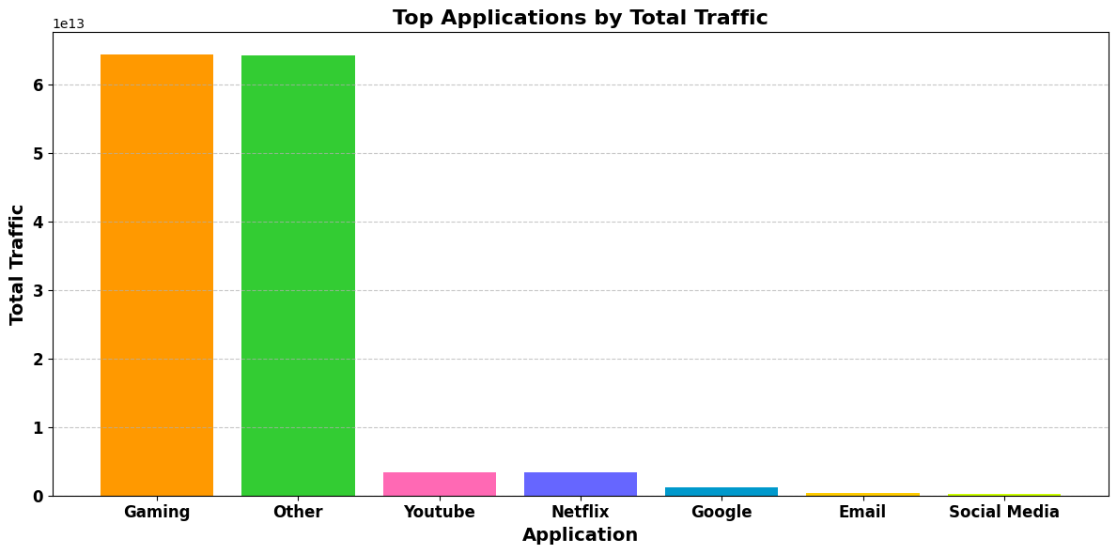
Top applications by traffic:

Slide 6
The bar chart illustrates the total traffic generated by various applications. The ranking reveals that:
Gaming dominates the traffic, indicating a strong user base with high engagement.
Other applications collectively contribute a substantial amount of traffic.
YouTube and Netflix follow closely, reflecting the popularity of video streaming services.
Google, Email, and Social Media trail behind, suggesting relatively lower traffic.
This analysis provides valuable insights into user behavior and application usage patterns.

Slide 7
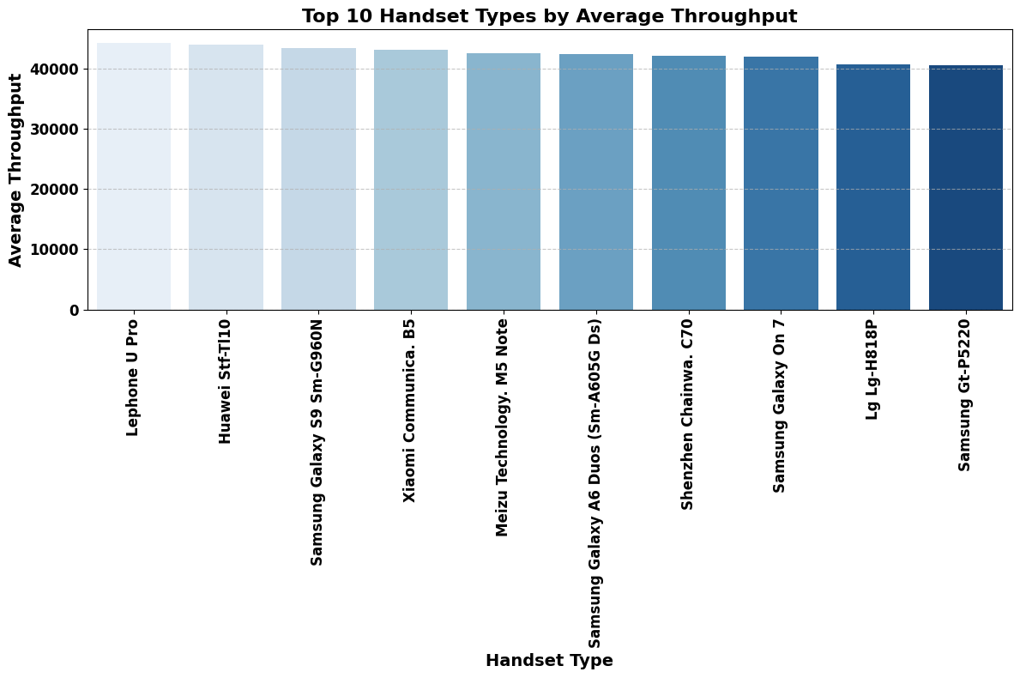
Top 10 Handsets by average throughput:

Slide 8
All handsets have high throughput: The average throughput for all top 10 handsets exceeds 40,000, indicating high-speed data transmission capabilities.
Variety of handset models: The top 10 list comprises handsets from different manufacturers, including LePhone U Pro, Huawei stf-TI10, Samsung, Xiaomi, and Meizu.
LePhone U Pro leads: The LePhone U Pro has the highest average throughput, followed closely by the Huawei stf-TI10.

Slide 9
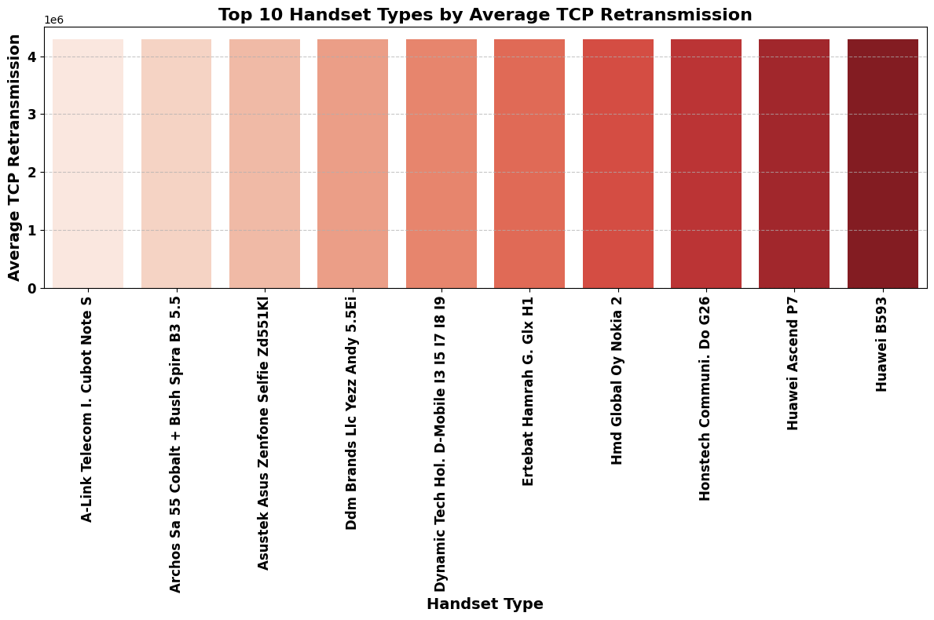
Top 10 handset by average tcp retransmission

Slide 10
High TCP retransmission rates: All top 10 handsets have average TCP retransmission rates above 4, indicating a significant amount of retransmitted data.
Similar retransmission rates: The top 10 handsets have relatively similar average TCP retransmission rates, suggesting that these handsets may be experiencing similar network conditions or issues.
No clear leader: Unlike the throughput graph, there is no clear leader in terms of TCP retransmission rate, as all handsets have similar rates.

Slide 11
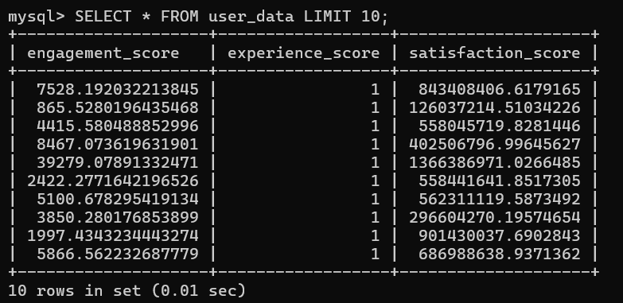

Slide 12
Engagement and Satisfaction Correlation
There is a positive correlation between engagement and satisfaction scores. As engagement scores increase, satisfaction scores also tend to increase.
This suggests that users who are more engaged with the product or service tend to be more satisfied.

Slide 13
Consistent Experience Scores
Experience scores remain consistent across all data points, with a score of 1.0.
This could indicate that the experience of using the product or service is uniform across all users.

Slide 14
Variance in Satisfaction Scores
Satisfaction scores vary widely, ranging from 126,037,214 to 1,366,386,971.
This suggests that there are opportunities for improvement in terms of satisfaction, as some users are much more satisfied than others.

Slide 15
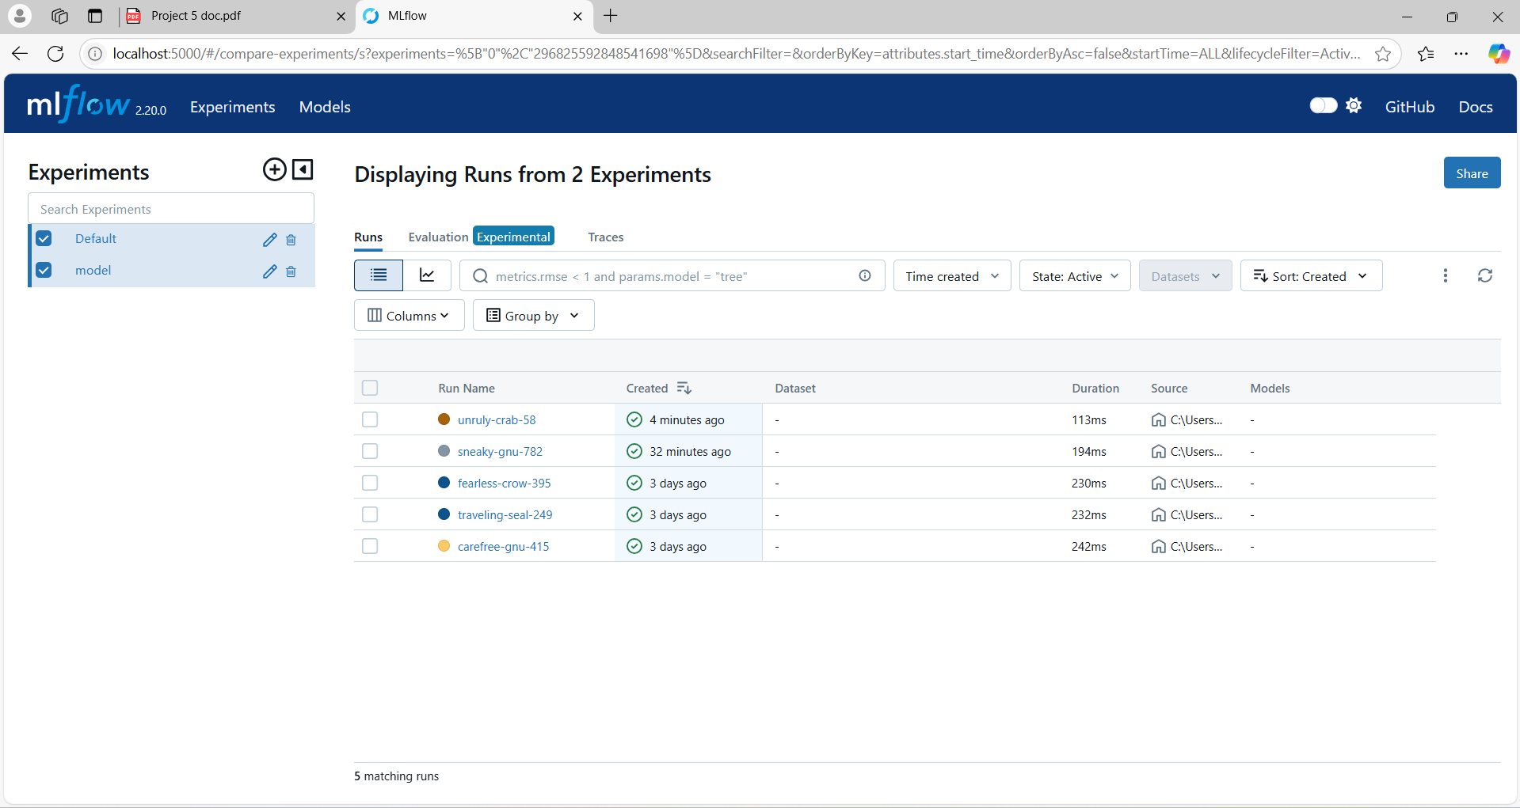
Model Tracking Report

Slide 16
Thank you

